Slide 1
MDD Project
SENTIMENT ANALYSIS USING R
Level 1 Implementation

Slide 2
Requirement analysis
An Intel-compatible platform running Windows 2000, XP/2003/Vista/7/8/2012 Server/8.1/10
2 GB RAM
2 GB Memory
R Studio 3.4.3
R i386 3.4.3
WhatsApp chat ( text format)
Internet connection

Slide 3
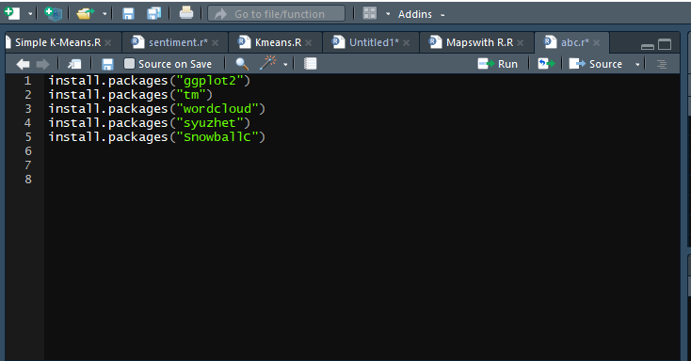
LEVEL 1 implementation
Libraries Required :
library(ggplot2)
library(tm)
library(wordcloud)
library(syuzhet)
library(SnowballC)

Slide 4
Ggplot2
The ggplot2 package, created by Hadley Wickham, offers a powerful graphics language for creating elegant and complex plots. Its popularity in the R community has exploded in recent years. There is a helper function called qplot() (for quick plot) that can hide much of this complexity when creating standard graphs.

Slide 5
TM – text mining
the tm_map() function is used to remove unnecessary white space, to convert the text to lower case, to remove common stopwords like ‘the’, “we”.
The information value of ‘stopwords’ is near zero due to the fact that they are so common in a language. Removing this kind of words is useful before further analyses. For ‘stopwords’, supported languages are danish, dutch, english, finnish, french, german, hungarian, italian, norwegian, portuguese, russian, spanish and swedish. Language names are case sensitive.
You could also remove numbers and punctuation with removeNumbers and removePunctuation arguments.

Slide 6
Wordcloud
One can create a word cloud, also referred as text cloud or tag cloud, which is a visual representation of text data. The text mining package (tm) and the word cloud generator package (wordcloud) are available in R for helping us to analyse texts and to quickly visualize the keywords as a word cloud.

Slide 7
SnowballC
SnowballC packageis used for text stemming. Text stemming reduces words to their root form. In other words, this process removes suffixes from words to make it simple and to get the common origin. For example, a stemming process reduces the words “moving”, “moved” and “movement” to the root word, “move”.

Slide 8
SYUZHET
This vignette demonstrates use of the basic functions of the Syuzhet package. The package comes with four sentiment dictionaries and provides a method for accessing the robust, but computationally expensive, sentiment extraction tool. The goal of this vignette is to introduce the main functions in the package so that you can quickly extract plot and sentiment data from your own text files.
get_nrc_sentiment
The get_nrc_sentiment function returns a data frame in which each row represents a sentence from the original file. The columns include one for each emotion type was well as the positive or negative sentiment valence. .

Slide 9
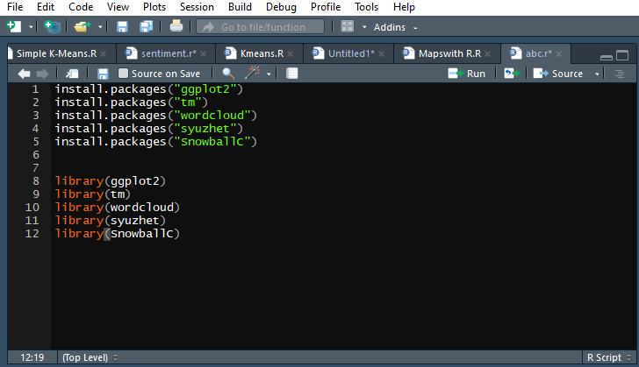
Loading the libraries
library(ggplot2)
library(tm)
library(wordcloud)
library(syuzhet)
library(SnowballC)

Slide 10
Loading the text file
setwd("F:/shub data") //used to set the working directory.
texts=readLines("wcsi.txt") //Reads the lines of the whatsapp chats and saves in the variable named as texts.
docs=Corpus(VectorSource(texts)) // It makes a collection of data that has to be operated.

Slide 11
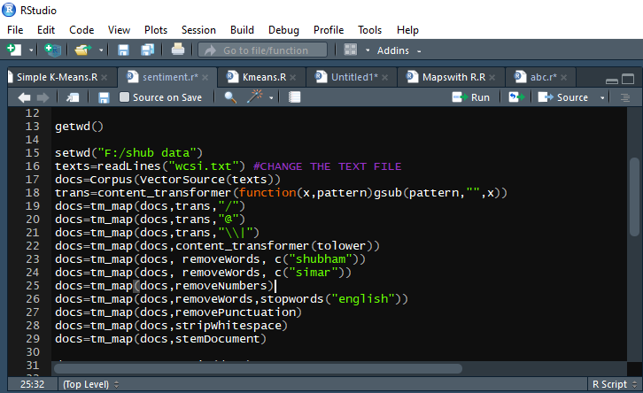
Cleaning the data
trans=content_transformer(function(x,pattern)gsub(pattern,"",x))
docs=tm_map(docs,trans,"/")
docs=tm_map(docs,trans,"@")
docs=tm_map(docs,trans,"\\|")
docs=tm_map(docs,content_transformer(tolower))
docs=tm_map(docs, removeWords, c("shubham"))
docs=tm_map(docs, removeWords, c("simar"))
docs=tm_map(docs,removeNumbers)
docs=tm_map(docs,removeWords,stopwords("english"))
docs=tm_map(docs,removePunctuation)
docs=tm_map(docs,stripWhitespace)
docs=tm_map(docs,stemDocument)

